Slide 1


Science and kids, nr. 2018-1-IT02-KA229-048230_5
E-cookery book
Traditional Romanian Food
"The European Commission support for the production of this publication does not constitute an endorsement of the contents which reflects the views only of the authors, and the Commission cannot be held responsible for any use which may be made of the information contained therein."

Slide 2
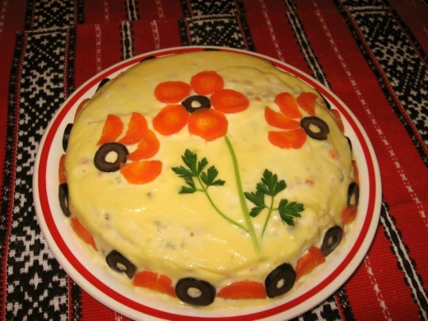
Salata de Boeuf (beef salad)
Ingredients:
Salad:
2 large russet potatoes
2 chicken breasts, cooked and diced small
1 cup peeled carrots, boiled and diced small
1 cup peeled parsnips, boiled and diced small
5 large hard-cooked eggs, diced
1 small onion, diced small
2 celery stalks, diced small
1 1/2 cups diced pickles
1 1/2 cups frozen peas
Dressing:
1 to 2 cups mayonnaise, or to taste
1 tablespoon mustard
Salt and pepper to taste
Garnish:
Parsley
Olives
Reserved hard-cooked eggs
Reserved cooked vegetables

Slide 3
Preparation:
Boil potatoes in their skins in salted water until fork tender. Remove from water and peel off the skin when they are cool enough to handle. Dice small and reserve.
In a large bowl, add potatoes, chicken or other meat, carrots, parsnips, eggs, onion and celery. Squeeze the diced pickles lightly in a paper towel to remove some of their juice (otherwise the salad will be too watery) and add to the rest of the diced ingredients.
Place frozen peas in a colander and run cold water over them to defrost. Drain completely, patting dry if necessary, and add to the other diced ingredients in the large bowl.
Make the dressing: In a medium bowl, combine mayonnaise, mustard and salt and pepper. Add to diced ingredients in large bowl and toss to completely cover.
Transfer to a pretty serving bowl. Cover the entire top with a thin layer of mayonnaise but enough so no salad shows through. Decorate the top with reserved vegetables and hard-cooked eggs. Cover with plastic wrap and place in refrigerator to serve chilled or serve immediately at room temperature.

Slide 4
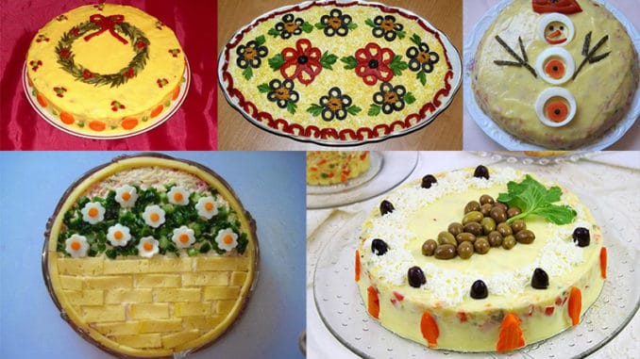

Slide 5
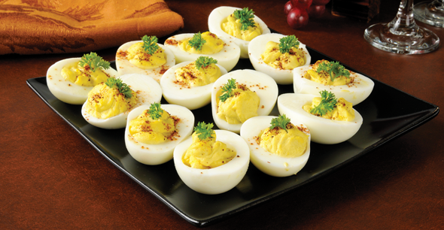
Deviled Egg (oua umplute)
Ingredients:
12 eggs
2 teaspoons horseradish mustard
2-3 tablespoons mayonnaise
half large onion
a pinch of salt
ground black pepper

Slide 6
Preparation:
Put the eggs in a pot with cold water.
Bring the water to boil, then make it simmer for at least 20 minutes.
Drain the water and put the eggs under cold running water for 2-3 minutes.
Peel the eggs and cut them along the longest diameter.
Pop out the yolks and put them in a bowl, then mash them with a fork.
Mix the mashed yolks with the mayonnaise until the mixture becomes creamy.
Add the grated onion paste (you can use a chopping machine on the finest setting) and season with the horseradish mustard, salt and ground black pepper.
Fill each half of the white shell with the creamy mixture.
Use parsley leaves for decorating the eggs.

Slide 7
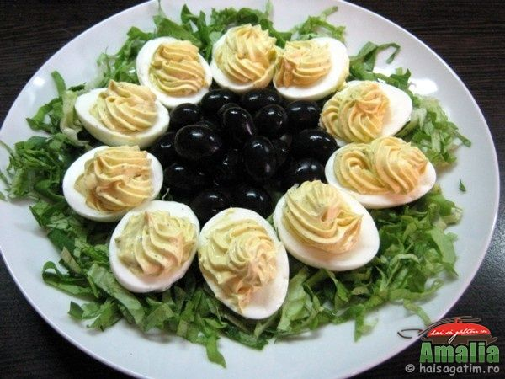


Slide 8
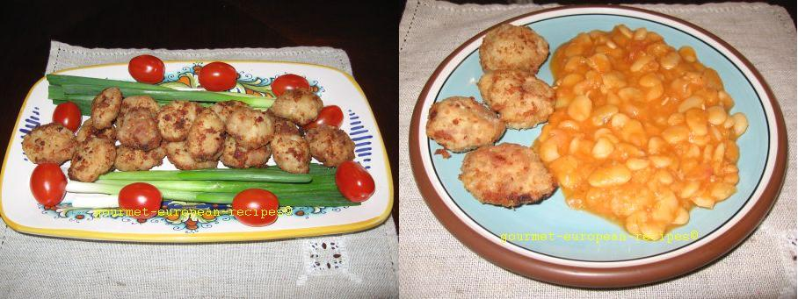
Meatballs (Chiftele)
Ingredients:
1 pound ground meat (mixed lean beef and pork)
1-2 bread slices
1/2 medium onion
2 minced garlic cloves
1 teaspoon finely chopped dill
salt
ground black pepper

Slide 9
Preparation:
Mix well the ground meat with bread soaked in water.
Season with salt and ground black pepper. Add minced garlic cloves, finely grated onion and finely chopped dill. Knead the mixture.
Form little meatballs with an ice scoop. Flatten the meatballs a little with your hands.
Preheat olive oil in a skillet/pan (about half the height of a meatball).
When the oil is warm enough (starting to get hot), add the meatballs to fill the bottom of the pan.
Let the meatballs fry for 3-4 minutes. Check the side on the bottom: when the meatballs become golden brown on the bottom side, turn them over to the other side.
When both sides turn golden brown, remove the meatballs using a strainer spoon.
Put the meatballs temporarily on a paper towel for absorbing the excess oil.
Arrange on a serving plate.

Slide 10
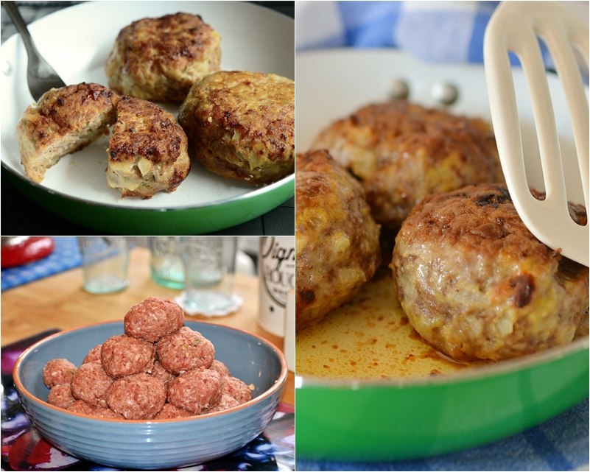

Slide 11

Tripe Soup (Ciorba de burta)
Ingredients:
2 pounds tripe
1 carrot
1 celery root
1 parsley root
1 onion
peppercorns (black pepper)
4-5 tablespoons sour cream
4-5 garlic cloves
3 tablespoons apple vinegar

Slide 12
Preparation:
Scrub and wash three times the tripe.
Put the vegetables and the tripe in a large pot with cold salted water. Simmer for 2 hours at low heat.
Drain the tripe and let it cool. Set aside the vegetables.
Cut the tripe into thin stripes and put it back in the broth.
Add the sour cream and some minced garlic.
Season it with more sour cream, vinegar, salt or minced garlic (taste and adjust the seasoning).
Serve with hot peppers on the side.

Slide 13
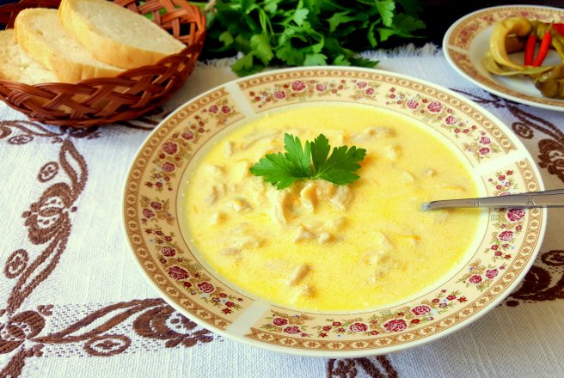
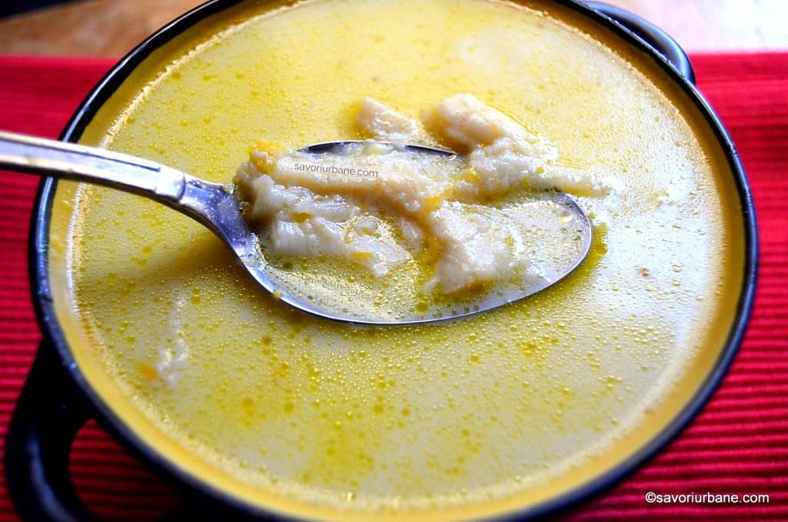

Slide 14
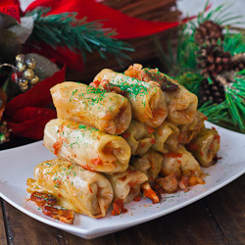
Cabbage Rolls (Sarmale)
Ingredients:
2 to 3 lbs ground pork (or whatever meat you prefer)
1/2 cup long grain rice
1-2 onions chopped
parsley
dill
2 tbsp vegetable oil
1 L tomato juice
salt and pepper to taste
1 large sour cabbage
15 slices of bacon

Slide 15
Instructions:
Chop the onions and fry them in the oil until tender. Add rice and cook for another minute. Add onion and rice mixture to ground pork and add salt, pepper, dill and parsley and mix well with your hands. Now it's time to assemble the rolls.
Remove all the cabbage leaves and cut each leaf in half. Romanian cabbage rolls are traditionally smaller than the Polish cabbage rolls, so that's why I recommend cutting each leaf in half, otherwise you can use the entire leave for one roll.
Fill each half leaf with a big tbsp of the meat mixture and roll. Put all the rolls in a big pot and add the liter of tomato juice over the rolls. Add more water if needed, the juice should cover the rolls entirely. Cover the pot with aluminum foil and bake at 375 degrees for about 4 hours.
After 2 hours remove the foil and put back in the oven. Serve hot with a bit of sour cream on top.

Slide 16
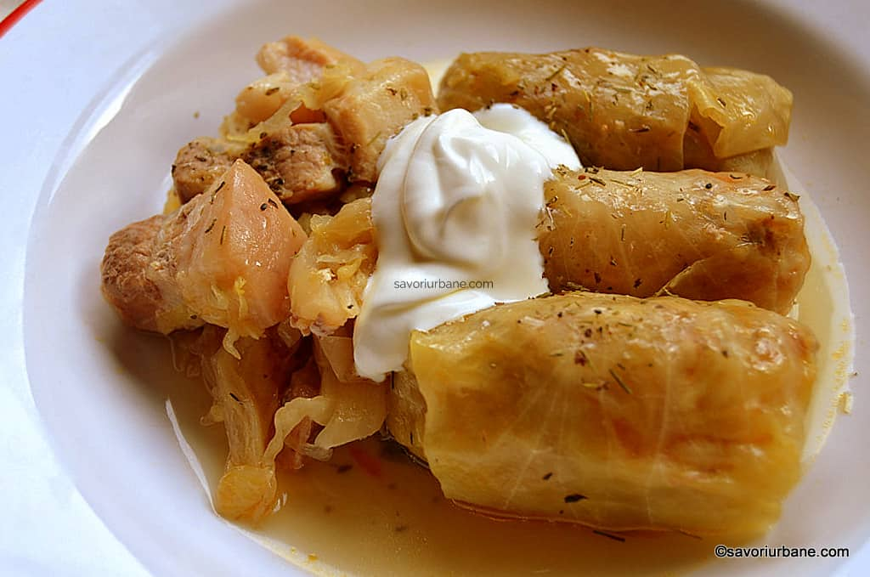
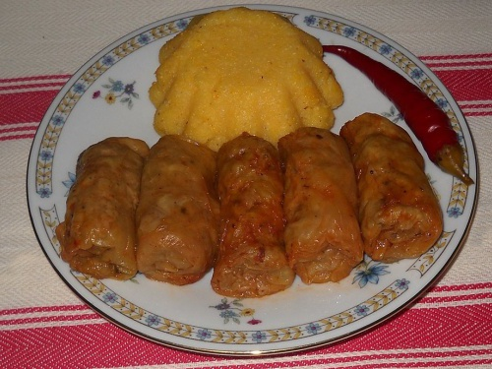

Slide 17
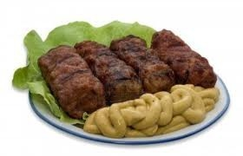
Mititei - Little grilled sausages (The Wee Ones)
Ingredients
2 lb. medium-lean ground beef( you can use lamb, mutton or pork instead or a combination of two)
2 tbsp. oil
2 tbsp. water
3 garlic cloves,crushed
2 tsp. bicarbonate of soda
1/2 tsp. dried thyme
1/2 tsp. crushed hot red pepper
1/2 tsp hot paprika
2 tsp. caraway seeds
2 tsp. salt
1 tsp. fresh ground black pepper

Slide 18
Place the ground beef in a big bowl and add all the ingredients. Mix them all very well and then knead mixture with your hands for at least 5 minutes wetting your hands frequently. Place mixture in a bowl, cover with a plate or with foil and put in the fridge for at least 5 hours or overnight. Use a tablespoon to take meat from the bowl and then with your hands make small meatballs. Roll between your hands into sausages about 4 inch long and 1 inch thick. Make them like little cylinders. Once ready grill or barbecue turning mititei frequently to cook evenly. While they cook baste frequently with water or beef stock to keep them moist. They should be ready in about 10-12 minutes.

Slide 19
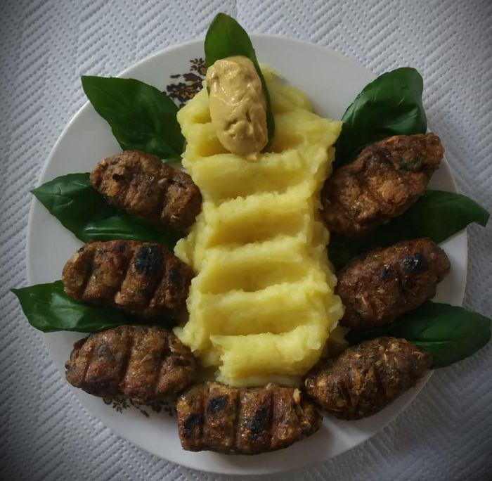
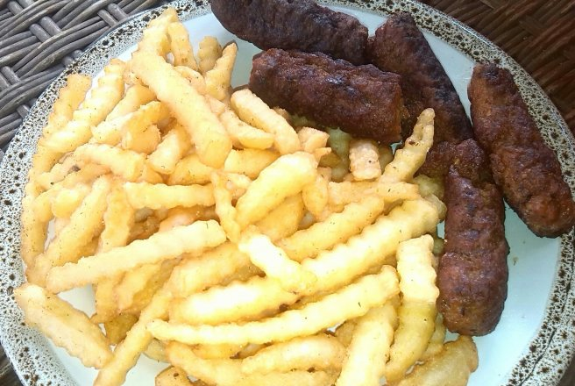

Slide 20
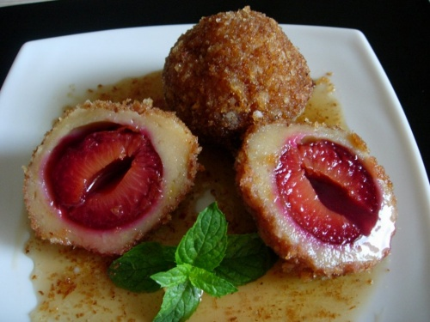
Plum dumplings
Ingredients:
for the dough:
1.2 kg potatoes
500 grams all-purpose flour
150 grams vanilla flavored powdered sugar
3 tbsp sunflower oil
2 eggs
a pinch of salt
for the filling
1.2 kg fresh plums, pitted and sliced in halves
100 grams brown sugar
2 tbsp ground cinnamon
or
250 dried plums (pitted)
2 tbsp brown rum
100 grams sugar
2 tbsp ground cinnamon
for coating
200 grams bread crumbs
3 tbsp butter
2 tbsp ground cinnamon
4 tbsp sugar

Slide 21
Firstly, prepare the plums. If you have fresh fruit, slice them in halves, remove the pits, place them onto a plate and sprinkle sugar and cinnamon over. Let them aside. If you use, as we did, dried plums, soak them in rum mixed with sugar and cinnamon until you prepare the dough.
For the dough, wash the potatoes and boil them in their jacket (about 40 minutes). Drain and let aside to cool. Peel the potatoes while still warm and mash them using a fork or a potato ricer.
In a big bowl, combine mashed potatoes with flour, eggs, oil and powdered sugar and knead until you get a soft dough.

Slide 22
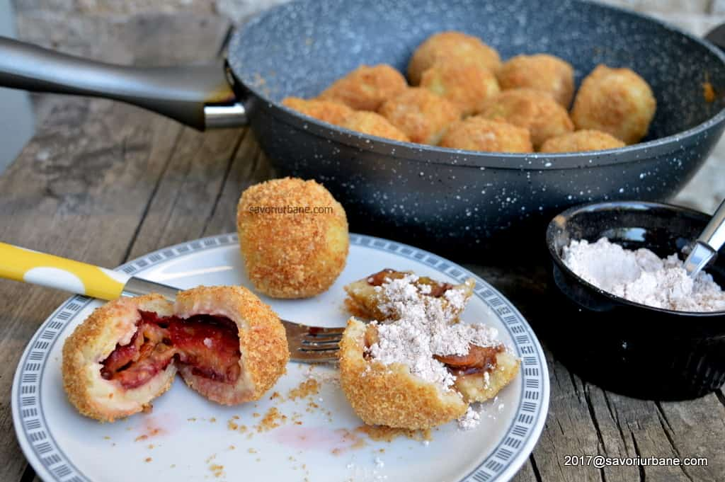

Slide 23
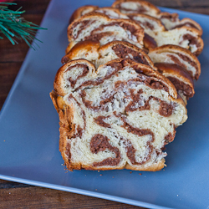
Walnut Bread (Cozonac cu Nuca)
Ingredients:
60 gr fresh yeast
250 gr chopped walnuts or pecans
1 kg all purpose flour
300 gr white sugar
5 eggs
500 ml milk
250 gr butter melted
2 tsp vanilla extract
2 tbsp cocoa powder
1/2 cup raisins
1/4 cup vegetable oil
zest from one lemon

Slide 24
In a sauce pan add the sugar, milk, butter and lemon zest then warm it up. Do not boil it, it just needs to be hot.
Meanwhile, take the yeast and mix it with 2 tbsp of warm milk, 2 tbsp of sugar and 1 tbsp of flour and mix it well. Let it rest, if the yeast is fresh you will see the mixture rise. Leave it for about ten minutes. In a big bowl add the flour and if you're using vanilla powder add it to the flour otherwise add it to the milk mixture. Add 5 egg yolks (the whites will be used for the pecan cream) to the milk mixture and mix well. Next I usually use my kitchen aid mixer with the dough or paddle attachment. Add the flour to the bowl of the mixer, the milk mixture and the yeast mixture as well. Mix well for a few minutes. In the old days you'd have to knead this by hand for at least half hour. The more it mixes the fluffier the dough will be. Add the raisins and mix well.
Let the dough rise for an hour or two until it doubles in size.
In the meantime, in a food processor add the pecans or walnuts, add 5 more tablespoons of sugar and the 2 tablespoons of cocoa powder and mix. In the mixer put the egg whites and mix until stiff then add the pecan mixture and mix. Put this mixture in the fridge.
After the dough has risen, divide it in 3 pieces. On a big surface where you can work the dough, oil the surface, we will not use flour here, oil or butter works better. Take one piece and roll it out and then add a third of the pecan mixture to the dough and roll it out. Put each roll in a buttered bread pan and let rise again until doubled in size. Next make an egg wash and wash each bread with egg then sprinkle some sugar over each loaf.
Bake at 350 degrees for about 35-45 minutes. Let cool completely before cutting into this.

Slide 25
